Slide 1
Keys /Finding Candidate Keys in a Relation
(A guide to understanding candidate keys in DBMS)

Slide 2
What are the different types of Keys in DBMS?
Keys are of seven broad types in DBMS:
Candidate Key
Primary Key
Foreign Key
Super Key
Alternate Key
Composite Key
Unique Key
1. Primary Key
The primary key refers to a column or a set of columns of a table that helps us identify all the records uniquely present in that table. A table can consist of just one primary key. Also, this primary key cannot consist of the same values reappearing/repeating for any of its rows. All the values of a primary key have to be different, and there should be no repetitions.
The PK (PRIMARY KEY) constraint that we put on a column/set of columns won’t allow these to have a null value or a duplicate. Any table can consist of only a single primary key constraint. A foreign key (explained below) that refers to it can never change the values present in the primary key.
2. Super Key
A super key refers to the set of all those keys that help us uniquely identify all the rows present in a table. It means that all of these columns present in a table that can identify the columns of that table uniquely act as the super keys.
A super key is a candidate key’s superset (candidate key has been explained below). We need to pick the primary key of any table from the super key’s set so as to make it the table’s identity attribute.

Slide 3
3. Candidate Key
The candidate keys refer to those attributes that identify rows uniquely in a table. In a table, we select the primary key from a candidate key. Thus, a candidate key has similar properties as that of the primary keys that we have explained above. In a table, there can be multiple candidate keys.
4. Alternate Key
As we have stated above, any table can consist of multiple choices for the primary key. But, it can only choose one. Thus, all those keys that did not become a primary key are known as alternate keys.
5. Foreign Key
We use a foreign key to establish relationships between two available tables. The foreign key would require every value present in a column/set of columns to match the referential table’s primary key. A foreign key helps us to maintain data as well as referential integrity.
6. Composite Key
The composite key refers to a set of multiple attributes that help us uniquely identify every tuple present in a table. The attributes present in a set may not be unique whenever we consider them separately. Thus, when we take them all together, it will ensure total uniqueness.
7. Unique Key
A unique key refers to a column/a set of columns that identify every record uniquely in a table. All the values in this key would have to be unique. Remember that a unique key is different from a primary key. It is because it is only capable of having one null value. A primary key, on the other hand, cannot have a null value.

Slide 6
Composite Key-
A primary key comprising of multiple attributes and not just a single attribute is called as a composite key.
Unique Key-
Unique key is a key with the following properties-
It is unique for all the records of the table.
Once assigned, its value can not be changed i.e. it is non-updatable.
It may have a NULL value.
Example-
The best example of unique key is Adhaar Card Numbers.
The Adhaar Card Number is unique for all the citizens (tuples) of India (table).
If it gets lost and another duplicate copy is issued, then the duplicate copy always has the same number as before.
Thus, it is non-updatable.
Few citizens may not have got their Adhaar cards, so for them its value is NULL.
Surrogate Key-
Surrogate key is a key with the following properties-
It is unique for all the records of the table.
It is updatable.
It can not be NULL i.e. it must have some value.
Secondary Key-
Secondary key is required for the indexing purpose for better and faster searching.

Slide 7
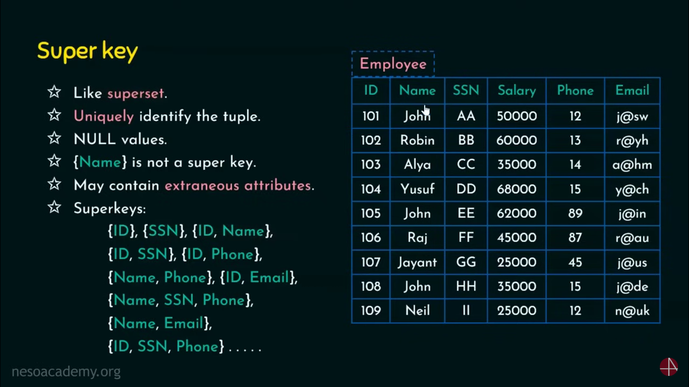

Slide 8
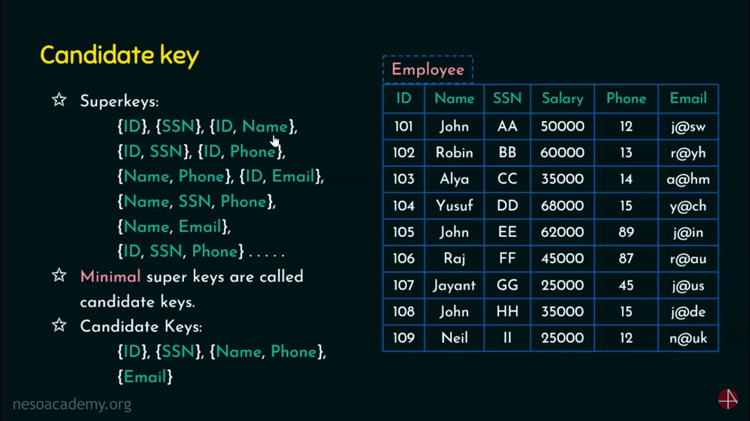

Slide 9
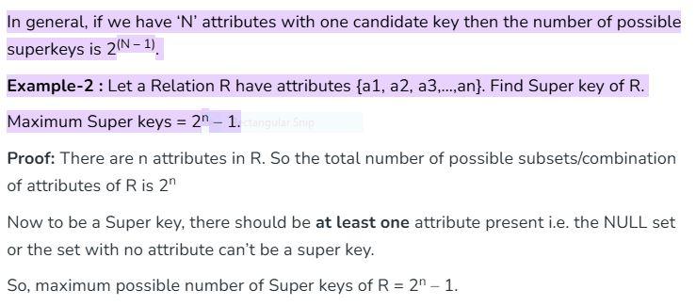
Contd..
All the attributes in a candidate key are sufficient as well as necessary to identify each tuple uniquely.
Removing any attribute from the candidate key fails in identifying each tuple uniquely.
The value of candidate key must always be unique.
The value of candidate key can never be NULL.
It is possible to have multiple candidate keys in a relation.
Those attributes which appears in some candidate key are called as prime attributes.

Slide 10
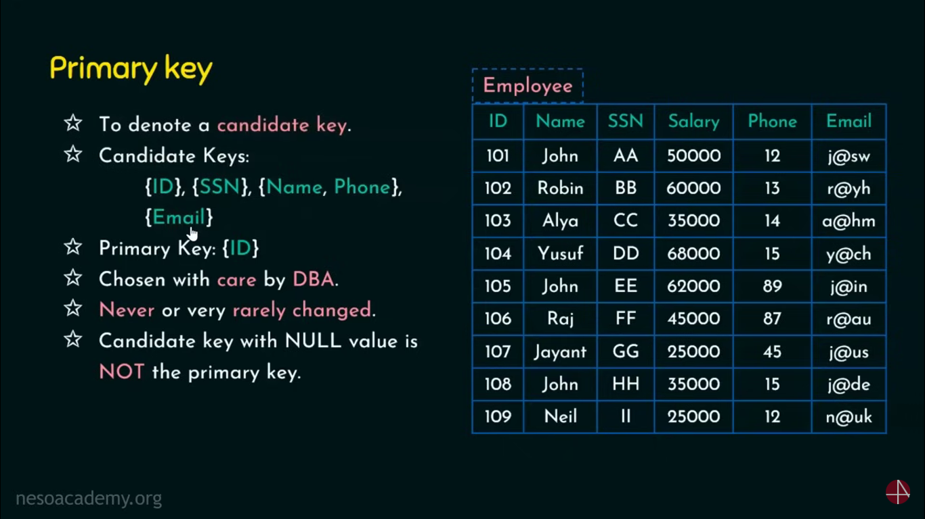

Slide 11
The value of primary key can never be NULL.
The value of primary key must always be unique.
The values of primary key can never be changed i.e. no updation is possible.
The value of primary key must be assigned when inserting a record.
A relation is allowed to have only one primary key.

Slide 12
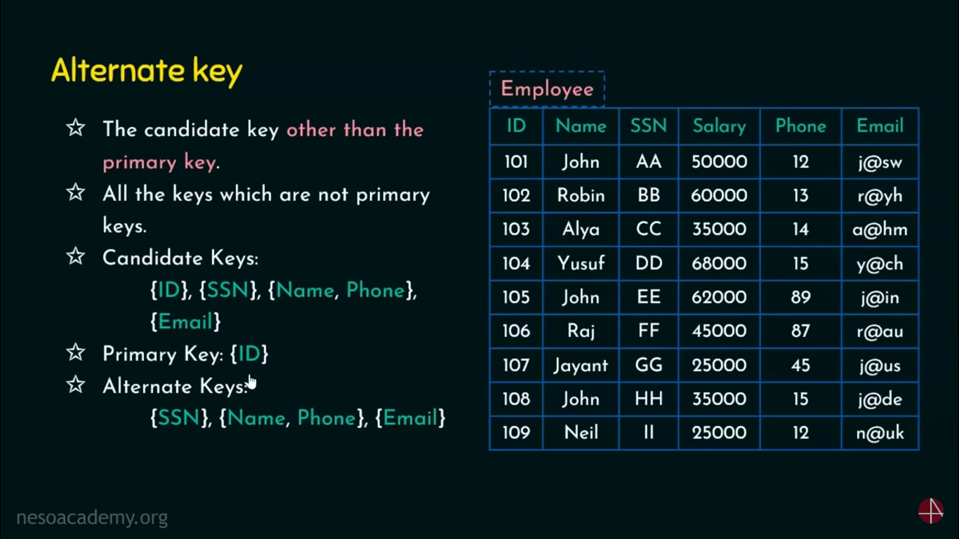

Slide 13
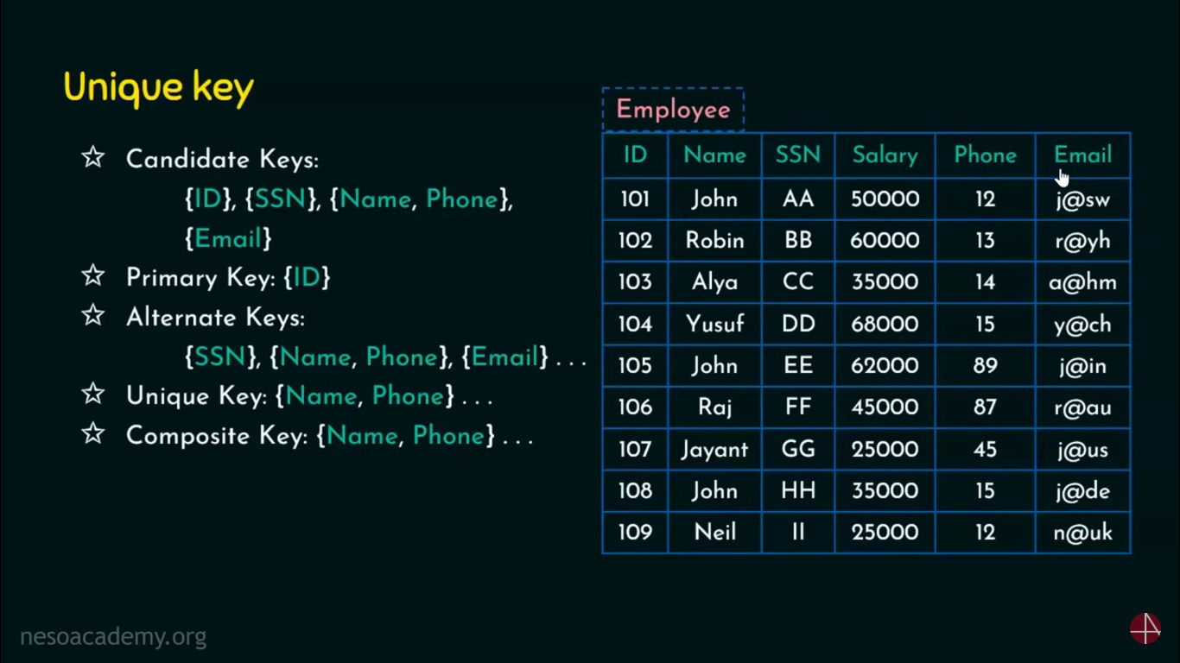

Slide 14
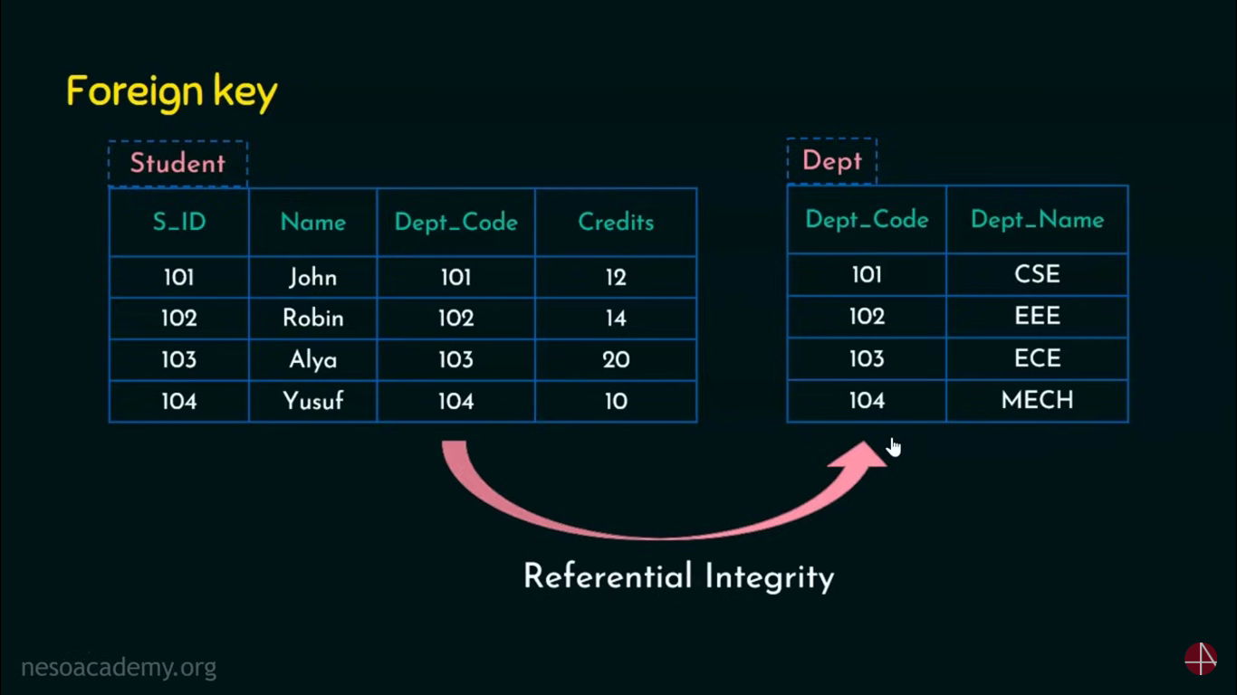

Slide 15
Foreign key references the primary key of the table.
Foreign key can take only those values which are present in the primary key of the referenced relation.
Foreign key may have a name other than that of a primary key.
Foreign key can take the NULL value.
There is no restriction on a foreign key to be unique.
In fact, foreign key is not unique most of the time.
Referenced relation may also be called as the master table or primary table.
Referencing relation may also be called as the foreign table.

Slide 16
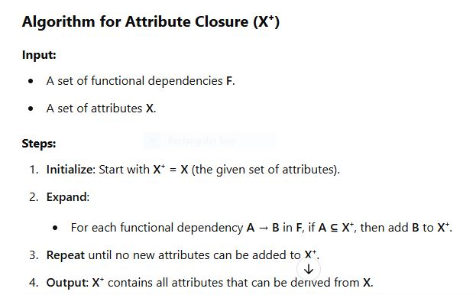
Closure Algorithm

Slide 17
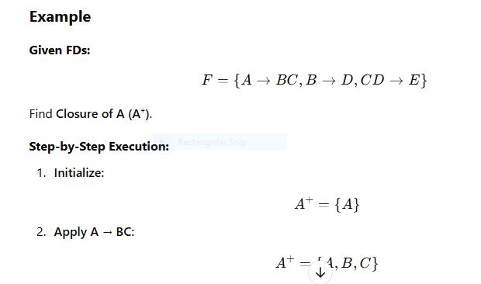
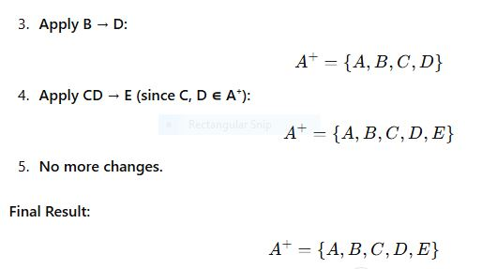
Ex

Slide 18
Applications of Attribute Closure
Checking if X is a Super key
If X⁺ contains all attributes in the relation, then X is a super key.
Finding Candidate Keys
If X⁺ contains all attributes and X is minimal, then X is a candidate key.
Checking Functional Dependencies
To verify if X → Y holds, check if Y ⊆ X⁺.

Slide 19
What is a Candidate Key?
- A Candidate Key is a minimal set of attributes that uniquely identifies a tuple in a relation.
- A relation can have multiple candidate keys, but one is chosen as the Primary Key.

Slide 20
Properties of Candidate Keys
1. Uniqueness – Each candidate key must uniquely identify every row in the table.
2. Minimality – Removing any attribute from the candidate key will make it lose uniqueness.

Slide 21
Steps to Find Candidate Keys
1. List all attributes of the relation.
2. Identify functional dependencies (FDs).
3. Compute attribute closure (X⁺) to determine which sets can uniquely identify all attributes.
4. Choose the minimal set(s) that satisfy uniqueness.

Slide 22
Example 1
Relation: R(A, B, C, D)
Functional Dependencies:
A → B
B → C
A → D
Finding the closure of A:
A⁺ = {A, B, C, D} ✅ (A determines all attributes)
Candidate Key = {A} ✅

Slide 23
Example 2 (Multiple Candidate Keys)
Relation: R(A, B, C, D, E)
Functional Dependencies:
AB → C
C → D
D → E
Finding the closure of AB:
AB⁺ = {A, B, C, D, E} ✅
Candidate Key = {AB} ✅

Slide 24

EX-3

Slide 25
Note
Prime attributes which are available in CK(AC,Ex-3)
A,C Prime Attributes(PA) Ex-3
To Check More than one CK present in relation we must chk any of the PA present in RHS of any FD,If not there is only One CK,
If Yes replace PA in CK with Corresponding LHS of FD
Repeat Finding SK and CK

Slide 26
Summary of Key Concepts
Superkey: A set of attributes that uniquely identifies each tuple.
Candidate Key: A minimal superkey.
Primary Key: One chosen candidate key.

Slide 27
Quick Tips
✅ Compute attribute closure (X⁺) to check uniqueness.
✅ Remove unnecessary attributes to ensure minimality.
✅ If multiple minimal keys exist, all are candidate keys.

Slide 28
Thank You!
- Any questions? 😊
- Happy Learning! 🚀

